Slide 1
Energy Forecasting
Milestone 3
2/13/19
John Matune, Steve Rummel, Mike Yacobucci

Slide 2
Agenda
Solar Power Production - Data Prep and initial Modeling (Rummel)
Wind Power Production
Power Consumption Modeling

Slide 3
Solar Power Production: Data prep and Modeling by Steve Rummel
Progress to date:
Initial data load completed milestone 2
Identified level of granularity for analysis
Identified independent variables for retention
Filled gaps in data
Prepared SARIMA model for dependent variable (Solar_KWH)
Next Steps

Slide 4
Identified level of granularity for analysis
I am modeling solar energy production at a daily level, as solar energy production is directly time-constrained and most independent variables are not directly constrained, i.e., you cannot gather solar energy at midnight, but there is precipitation, dew point, etc. which may be somewhat related to day/night heating and cooling cycles, but not as related as energy production.
While our overall analysis has a goal of matching production with consumption by hour, this is an intrinsic flaw – we know from our initial analysis that energy consumption spikes at times when solar power drops. For example, in summer, in the late afternoon, people leave work, go home and turn on their air conditioners (we see the spike and infer this behavior), but solar energy production wanes during this timeframe.
We are coordinating our analysis so we can, if and when possible, convert to an hourly analysis across solar and wind production and consumption. An alternative is to assume the existence of batteries, dynamos or other method of storing energy from high-production times for later expenditure.

Slide 5
Identified independent variables for retention
Removing 'Solar_Elevation', as there is no good way to aggregate this by day, nor is it necessarily relevant except as a performance measure of the solar array, which is not under analysis.
Removing ‘Wind_Speed_at_Windfarm’, as we have a wind speed measure and it is more likely wind at the solar array would impact production than at the windfarm (e.g., by shaking or destabilizing the array)
Retaining:
'Cloud_Cover_Fraction' - Average by day
'Dew_Point' - Average by day
'Humidity_Fraction' - Average by day
'Precipitation' - Average by day
'Pressure' - Average by day
'Temperature' - Average by day
'Visibility' - Average by day
'Wind_Speed_AT_SOLARRAY' - Average by day

Slide 6
Filled gaps in data
Insert records for missing date-times (current granularity: 24-hour)
Impute missing values for independent variables by linear interpolation between adjacent hours, on the assumption that weather changes, but not so suddenly that we would expect huge variance in the pace of an hour.
Aggregate independent variables by averaging their values (e.g., average precipitation, cloud cover, etc.) as these factors would impact daily solar production in aggregate, but not in an additive or max/min manner.
Aggregate solar production by summation, as we are measuring total solar production within a day. As noted previously, this aggregation removes (much of) the direct effect of day/night cycles.

Slide 7
Prepared SARIMA model for dependent variable (Solar_KWH)
Using the Python 3x ‘statsmodels’ SARIMAX model
Iteratively determine the best values for:
  p (number of days to ‘look back’
  d (how many times one should apply the time differencing operator)
  q (the number of prior errors that should influence the current period value)
  (P, D, Q, S) seasonal component of the Seasonal ARIMA model (generally analogous to the above, but related to the seasonal component of the model)
    P: Number of seasonal autoregressive (SAR) terms
    D: Number of seasonal differences
    Q: Number of seasonal moving average (SMA) terms
    S: Number of periods (Note: we have daily data, but we expect variations by month or season)

Slide 8
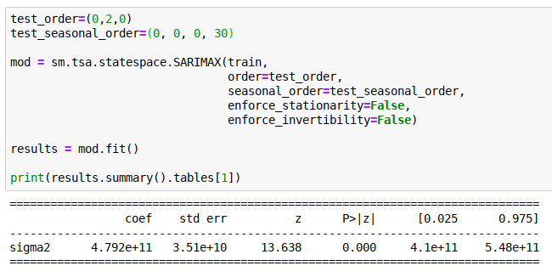
Initial SARIMA Model

Slide 9
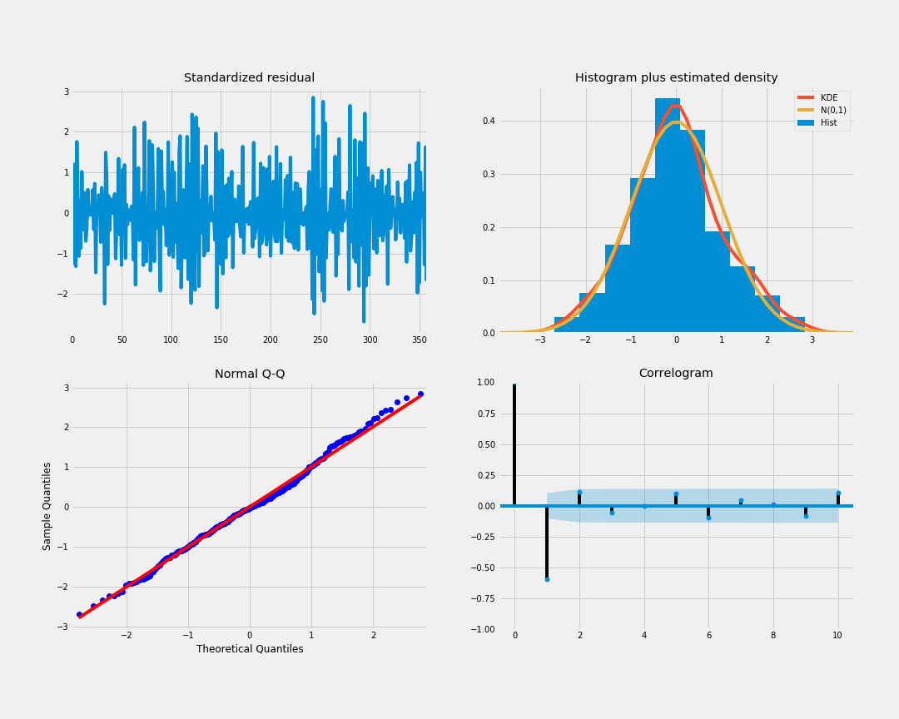
Initial SARIMA Model: Results
We want to verify that the residuals of our model are uncorrelated and
normally distributed, with a mean of zero.
In this case, our model diagnostics suggests that the model residuals are roughly normally distributed based on the following:
Top right plot, the red KDE line follows the normal distribution (N(0,1)), indicating that the residuals are roughly normally distributed.
The qq-plot on the lower left shows that the ordered distribution of residuals (blue dots) follows the linear trend of the samples taken from a standard normal distribution with N(0, 1), indicating that the residuals are roughly normally distributed.
The top left plot of residuals over time show no pattern (i.e., appear random), and the correlogram plot on the lower right shows that the time series residuals do not correlate with lagged versions of itself.
This is generally a decent start - we have seasonality, and we can account for almost all of it in our model.

Slide 10
Next Steps
Continue to refine the SARIMA model, especially:
Find optimal lookback period that yields insight (i.e., better predictive results)
Find optimal P, D and Q values for the seasonality component
Integrate independent variables to the model using an array of exogenous regressors (‘exog’) as inputs to the model
Integrate output with Wind production and consumption

Slide 11
Power Consumption Modeling
Modeling Strategy
Preprocessing
Model Details
Next Steps

Slide 12
Modeling Strategy
Break from pure forecasting - instead attempt a tree-based modeling approach to predict energy consumption based on conditions of that hour
  Built bagged and boosted model types
Seasonality to be learned by model based on time features
Success measure: RMSE (hourly level) and R^2 score (built in)
Tuning method: Random search

Slide 13
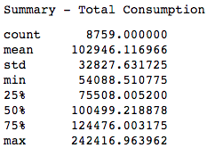
Consumption Preprocessing
Join weather data to city consumption data by hourly index
Create string variables for Month, Day and Hour
Sum sector consumption to generate target variable
Produce dummy variables for categoricals
  Final modeling set size: 8,759 Rows x 104 Features
Split into test & train
  Used 80/20 train vs test split
Did not normalize any numeric features for these models

Slide 14
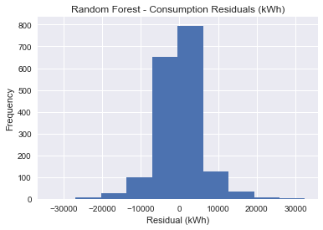
Model Type 1: Random Forest
Built using scikit-learn’s RandomForestRegressor
Best Parameters:
  Max Depth: 50
  Max Features: 74
  Estimators: 175
Results
  R^2
    Train - 0.9957
    Test - 0.9699
  RMSE (kWh)
    Train - 2,155
    Test - 5,631

Slide 15
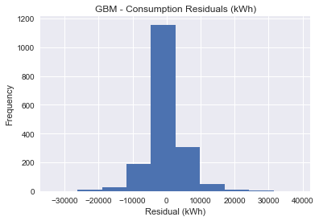
Model Type 2: Gradient Boosted Machine
Built using scikit-learn’s GradientBoostingRegressor
Best Parameters:
  Max Depth: 50
  Max Features: 74
  Estimators: 175
Results
  R^2
    Train - 0.9973
    Test - 0.9726
  RMSE (kWh)
    Train - 1,722
    Test - 5,375

Slide 16
Next Steps
Analyze residuals based on time of day or other factors to understand where model has most difficulty
Seek performance improvements with additional model types
  Try other boosted types (Adaboost, XGBoost, etc) since GBM model reflected slightly better performance than bagged approach
Apply RNN to consumption data to understand performance difference between tree-based models

Slide 17
Wind Power Production Modeling
Modeling Strategy
Preprocessing
Model Details
Next Steps

Slide 18
Modeling Strategy
Forecasting methods, first ARIMA, then SARIMAX
One-Step ahead forecasting
Success measure: MSE (hourly level) and Graphical compared against a baseline model method.
  The baseline model is a simple persistence model, i.e. the next step is the same as the previous.
Tuning method: Eyeball, (Future: Grid Search)
Notes:
One Step Ahead forecast: Forecast the next one, then shift my window one ahead and forecast the next, continue.

Slide 19
Wind Power Preprocessing
Had to decide how to handle missing Wind Production data. There were several extended periods of missing data ranging from a couple hours to almost 3 days of missing data. Decided to use simple linear interpolation.
Had to decide how I wanted to split my train and testing set. Decided to begin varying my training set size to see how that affected predictions. I.e 24 hour training set, 48 hour training set, 1 week training set, 1 month training set, etc. etc.

Slide 20
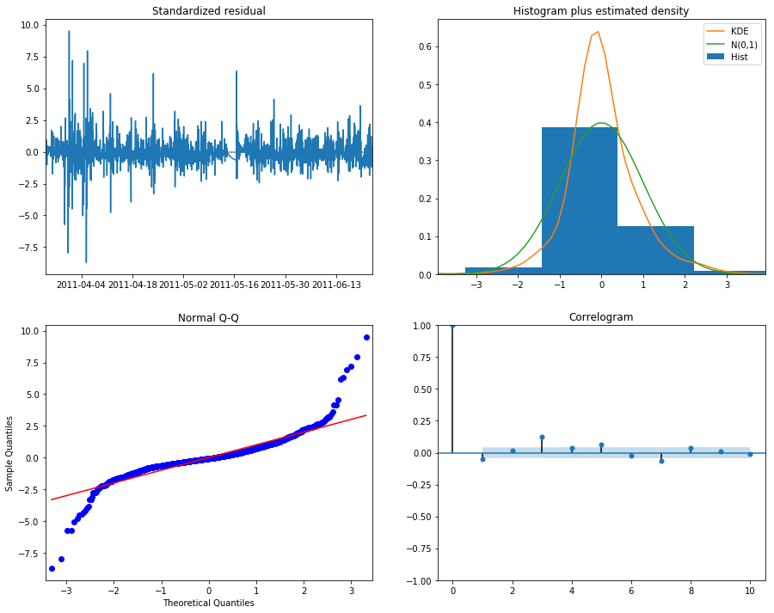
ARIMA Model
Example Parameters:
  Train Size: 3 months (24*90)
  Test Size: 24 hrs
  ARIMA(1,0,1)
Results
  Forecast MSE
    ARIMA - 50,208,043
    Persistence - 37,235,909
  AIC - 42,586
Notes:
It was hard to find a good ARIMA model. out of the random samples I tested, none performed better than the baseline method.

Slide 21
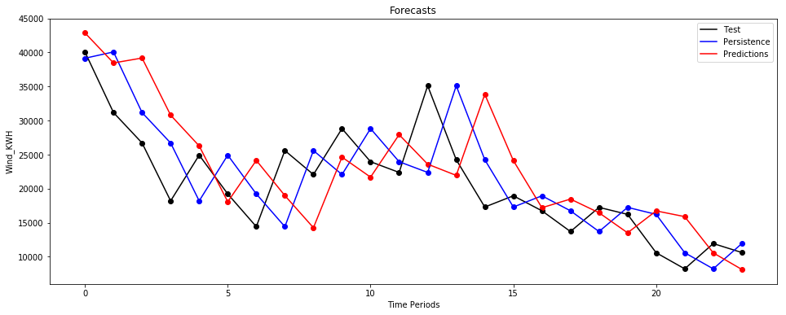
ARIMA Forecast Plot

Slide 22
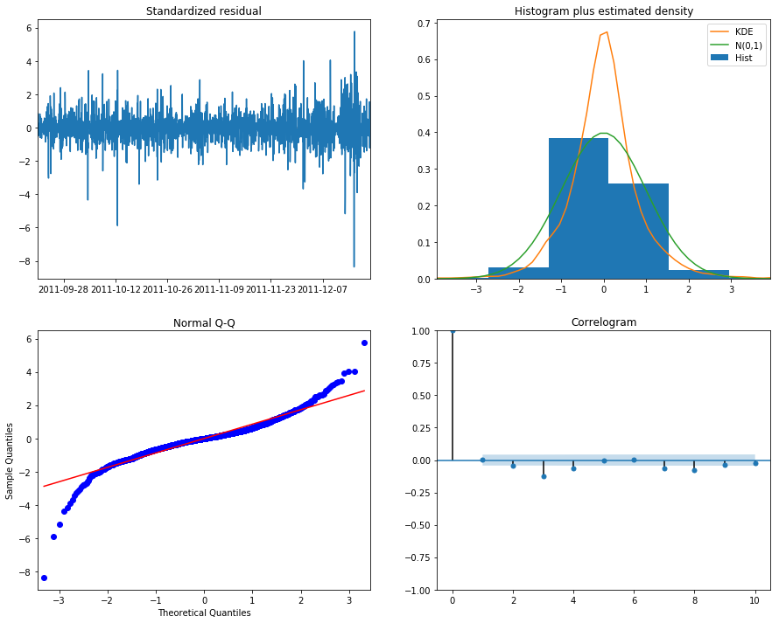
SARIMAX Model
Example Parameters:
  Train Size: 3 months (24*90)
  Test Size: 24 hrs
  SARIMAX(1,0,1)(0,0,0,0) with Wind Speed
Results
  Forecast MSE
    SARIMAX - 11,119,427
    Persistence - 37,235,909
  AIC - 39,754
Notes:
Adding an exogenous regressor instantly increased performance.

Slide 23
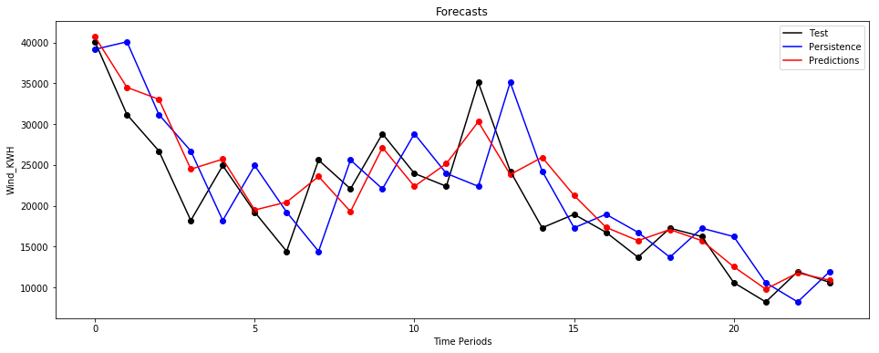
SARIMAX Forecasts

Slide 24
Next Steps
Analyze residuals based on a more robust search of training sizes and time periods.
  I do not think simple ARIMA models will work for wind production, as I have not found any that perform better than persistence.
Determine if wind speed for the next hour is an appropriate predictor.
  Shifting wind speed back an hour, SARIMAX still outperforms Persistence, however only marginally.
Figure out if SARIMAX provides confidence intervals on forecasts (ARIMA does)

